Slide 1

NBA Player Analytics Final Presentation
Aug 18th, 2021

Slide 2

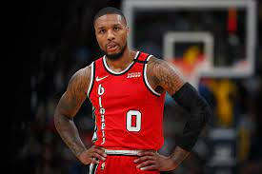
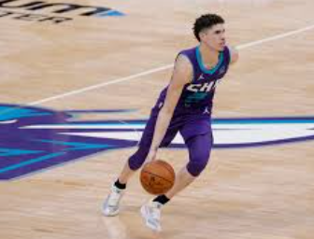
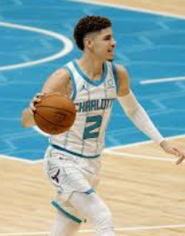

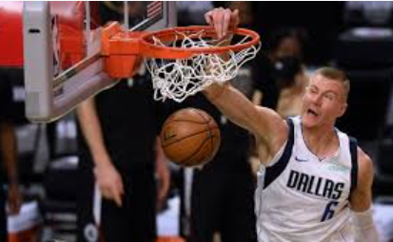
Team D&A Champs
WE BELIVE IN DATA DRIVEN INFORMATION
Team Members | Role play
Dave Sud | Data discovery & Database Engineer
Dhana Prakash | ETL Engineer
Rajesh | Business Intelligence Engineer
Asit | Solution Architect & Machine Learning Engineer
Project Coach– Ammad Rashid

Slide 3



Use Case-1
NBA wants to add a new team called 'Yellow Devil'. Ammad Balmer, a tech savvy billionaire would be the owner of this new team and he hired Ryan Ujiri as his president of basketball operations. Ryan is an expert in using analytics to measure player and team performance. Ryan is planning to have a Data & Analytics solution in place so that he and Ammad together can build a good and competitive team using the solution.
Ryan has a vision to create a solution that will go over players' playing statistics for last few seasons and suggest different tiers of players to choose from so that he makes a balanced team within budget(i.e., Salary Cap for the year is 110 Million USD).
Ryan has been provided with a budget to build this Data & Analytics solution. He went ahead and hired this team called D&A Champs to fulfil his Data & Analytics vision.
Use Case- 2
Also Ryan has another vision to fulfil. He has a vision to build a Data & Analytics solution in place using which a NBA player can predict whether his salary will increase or decrease in next 4 years based on his first season's playing statistics.

Slide 4
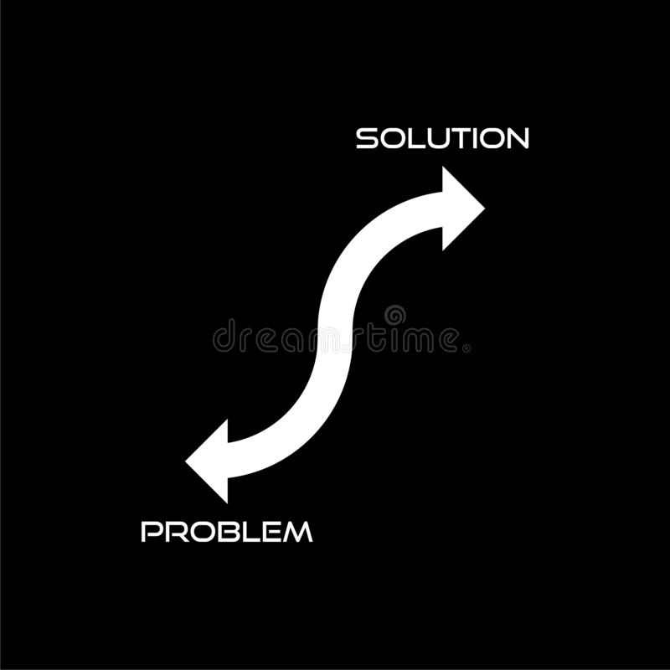

Problem Statement | Solution Approach | Guideline
Where & how to get players’ historic data ? | Discovered four seasons' data (Playing stats and Salary) from Kaggle | Dataset should be decent in size.
How to do the ETL and data clean up? | Through python scripts | ETL solution should be scalable.
Where to keep the processed data? | SQL Database | Dimensional modeling should be used so that querying is faster.
How to come up with different tiers of players? | Machine learning(Un-supervised learning) | Model should come up with Tiering along with player positions and write back to DB.
Where and how Ryan and Ammad can visualize the players with information to choose from? | Through Business Intelligence tool | Dashboard solution will be automatically scaled
How can a player predict whether his salary will go up or not in future based on his playing skills? | Machine learning(Supervised learning) | Model should be tuned to decent accuracy (>70%)

Slide 5
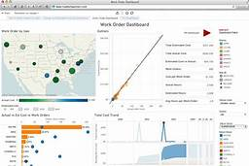




Solution Architecture
Supervised
& Un-supervised
Highlights:
Visualization
Tableau
M/C learning
PG
Databases
Postgres
ETL/Pre-processing
Python Scripts

Slide 6

PGADMIN
Ingested around 1036 records to PLAYERS_STATS_F
Ingested around 1015 records to PLAYERS_SALARY_F
Python techniques used in ETL
SQL Alchemy used to connect to database and insert records.
Around 1036 records (259 players * 4 seasons) inserted into statics table and salary table.
It is always a full load.
Use Lambda functions
Use Regular Expression (convert Currency to Float)
Group by to Aggregate Player Salary
Use of OS library to check file existence
Use dictionaries to count frequencies of values in columns
.loc for filtering
Splitting the string through split method.
Use map method to apply a function to data frame column.
Upload to DB Script
Load
Removed null values, converted data types
Aggregated player salary per season whenever players are traded
Filtered players played in all Seasons (around 259 players) to be loaded to DB.
Column names properly named as per naming convention used.
Transformations & Cleanup
Transformation
Four player statistics (one per season) files were referenced from Resource folder.
All files were standardized through python logic to have same format.
All player stats file were merged to one single stats file.
All player salary files were merged to one single salary file.
Standardization(Consolidation of all CSV files to have same format) and make one big file
Extract
Needs modifications to scale out
Remains unchanged to scale out

Slide 7
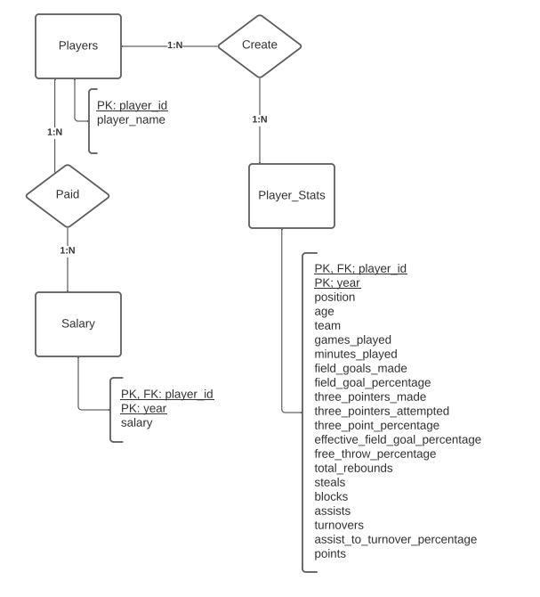
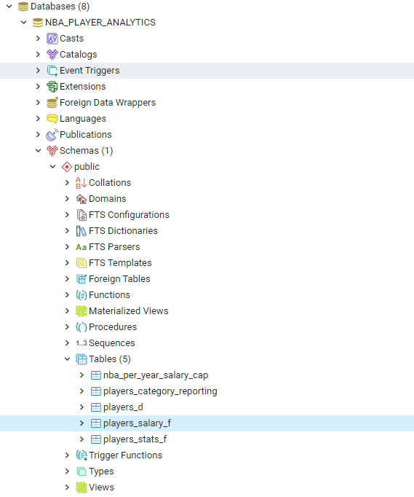
ER Diagram:
DB Snapshot:
LOGICAL DESIGN
PHYSICAL DESIGN
Techniques used
Highlights:
Dimensional Modeling done in logical design(2 Fact Tables and 1 Dimension table loaded through ETL).
1 Reference table ‘nba_per_year_salary_cap’ used for Machine learning(for Supervised Learning).
1 Write back table ‘players_category_reporting’ from Machine Learning (Output from un-supervised learning and consumed by Dashboard).

Slide 8

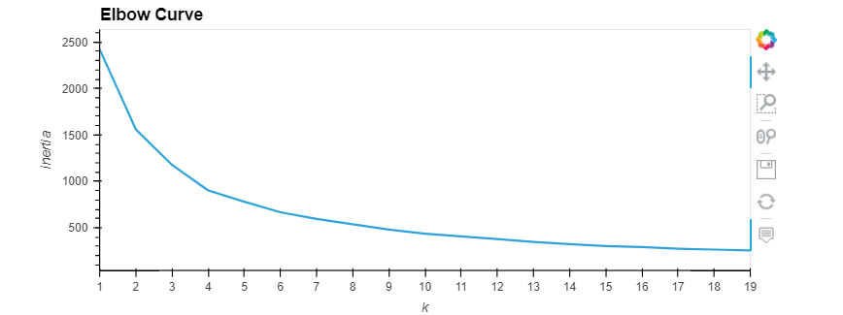
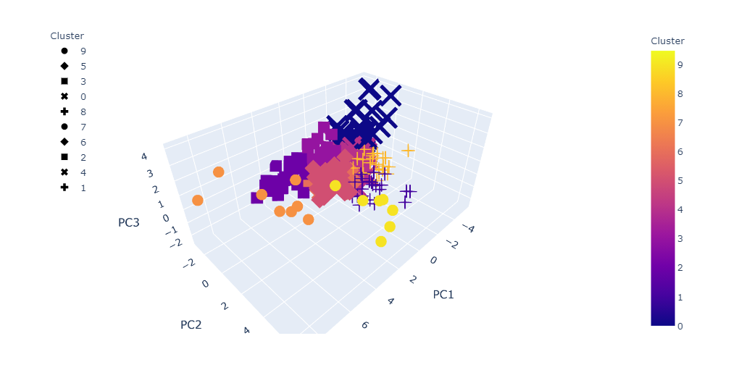
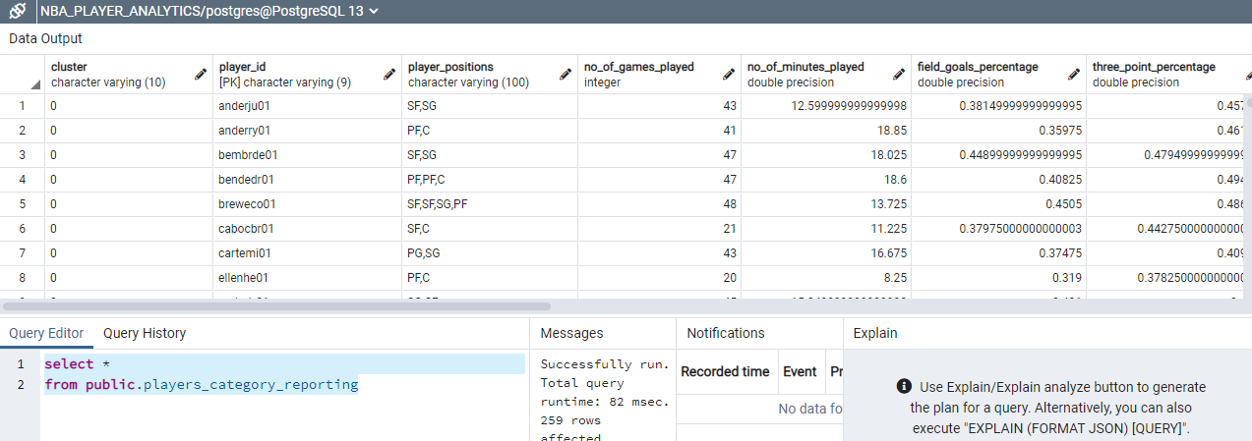
Techniques Used:
Output:
SQLAlchemy for read and write to database.
Player Statistics have been averaged per player across 4 seasons (2016, 2017,2018 & 2019) to fit into KMeans.
All Statistics(Features) scaled through Standard Scalar.
Principal Component Analysis performed.
Elbow curve derived to find out the value of K(no of Clusters).
KMeans performed to predict clusters of players.
Derive Average player Salary per cluster of players.
Tiering of Clusters done based on average salary of the players belonging to the corresponding clusters (Tier -1 for cluster with max salary average and Tier-10 for cluster with min salary average)
Players accordingly belong to the respective tiers.
Problem Statement:
Create the Tiers of players based on player statistics and write back to the database for the Dashboards to reflect.
Resolution:
Clustering through un-supervised learning.
KMeans used for Clustering.
Python scripting used.

